Slide 1
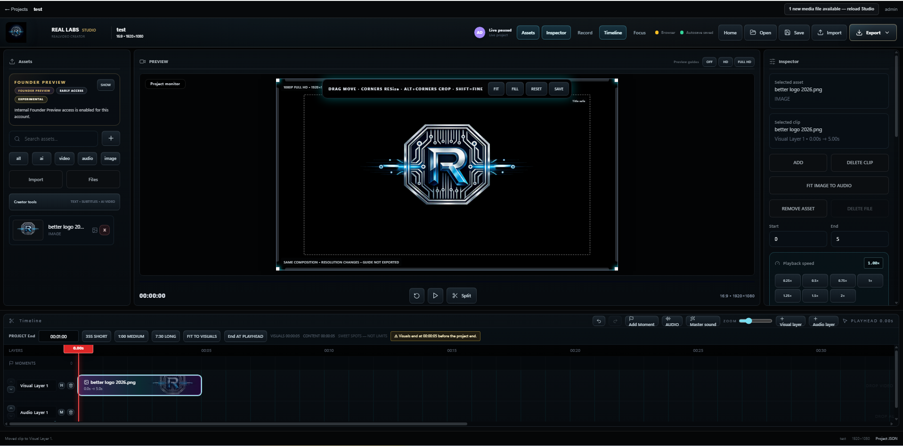
REAL LABS / INVESTOR OVERVIEW
I built the tools
I wished I had.
I launched a working creator studio.
I built a native streaming engine.
My working RVC Studio
I BUILT RVC • I AM PREPARING REAL GAMERS • I AM RAISING $500K
I have not yet connected Real Gamers with RVC. I am funding that next chapter.

Slide 2
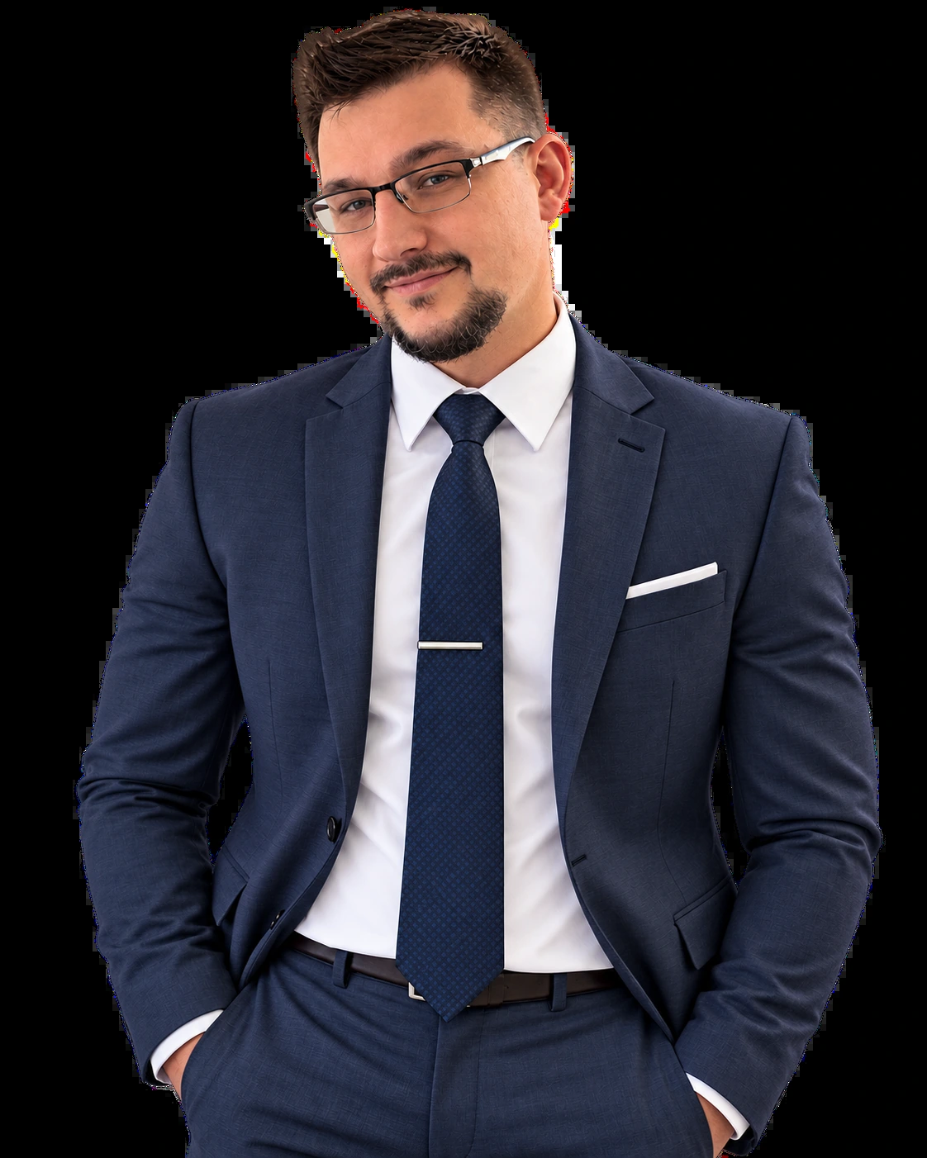
FOUNDER
I built this because the tools got in my way.
I started with game scripts. For roughly seven years, I engineered graphics, capture, editing and creator software without outside capital.
I nearly shut down after my first launch struggled. I learned that working technology needs distribution. I am raising capital to reach creators.
Devin Honson | Founder
~7 years
$0
~$190/mo
Independent build
Outside capital raised
Historical cash expense
I report my development history and costs. My historical cash expense excludes unpaid labor.

Slide 3
THE PROBLEM
I got tired of using five tools for one video.
I kept paying with time and subscriptions to move between capture, editing, narration and export.
Capture
Edit
Narrate
Polish
Export
I captured footage.
I moved it into an editor.
I left the edit for voice.
I added effects elsewhere.
I exported and revised.
I want creators to spend more time making things and less time switching tools.
I have not yet measured a controlled cost or workflow-time advantage against other tools.

Slide 4
THE STUDIO | LIVE NOW
I built the Studio. It is live.
I brought the timeline, media library, preview, voice tools, collaboration and export into one workspace.
I invite investors to try the working Studio. Some features require an account.

Slide 5
CREATIVE CONTROL
I put the creator in control.
I built the editor first. I offer optional generation with a clear quote before a supported paid job starts.
MAKE
CHOOSE
APPROVE
I built the Studio
I show the price first
I charge with approval
I let creators edit their projects directly and make their own creative decisions.
I quote supported generation before asking a creator to proceed.
I require approval, then track reservations, payment and generation states.
I built it for people to create first and enhance only what they need.
I continue to validate quote accuracy and operating margin across generation workloads.

Slide 6
REAL GAMERS | PRELAUNCH
I built the capture side too.
I developed the Windows-native Real Gamers engine. I still need to complete the consumer launch.
MY ENGINEERING
MY LAUNCH PRIORITIES
I developed the native core
I know what remains
I built Rust, D3D11 graphics, capture, hardware encoding, streaming, recording and replay systems.
I need to finish overlays and alerts, harden known reliability issues and test with streamers.
I run RVC and Real Gamers separately today. I want to connect them later.
I have not yet proven production-scale performance or shipped an RVC integration.

Slide 7
DISTRIBUTION
I built the invitation path already.
I created unique streamer discount codes and personalized invites in RVC billing. I want to turn that system into measurable partnerships.
INVITE
ACTIVATE
MEASURE
I offer a personal code
I help creators finish work
I track repeat use
I can offer selected streamers discounted RVC Pro access with a unique invitation.
I will onboard pilots to a real stream or export and learn from what they do.
I will measure code redemption, paid conversion, creator return and acquisition cost.
I built the invitations. I am raising capital to prove the partnerships.
I have not established paid partner conversion or signed pilot counts. The streamer-code capability appears in my source audit.

Slide 8
COMPETITION
I wanted one workflow, not another stack.
I respect specialist tools. I built RVC because I wanted fewer handoffs and more control in one place.
Tools I studied
What I respect
Why I built RVC
OBS / Streamlabs
I respect live capture and broadcast
I want a path from capture to editing and export
CapCut / OpusClip
I respect clip editing and repurposing
I want voice, timeline and export in one project
ElevenLabs
I have seen speech, studio and media generation grow
I prioritize editing first, with optional priced generation
I built RVC for editing and export. I plan Real Gamers as a native capture entry point.
I have not independently benchmarked feature parity, workflow time or cost against these providers.

Slide 9
EVIDENCE
I built the product. I still need to prove demand.
I will not describe internal tests, account records or traffic as paying customers.
Live
Daily
$0
I shipped the Studio
I track usage
I report $0 revenue
I have a deployed media pipeline, collaboration and billing paths.
I built usage tracking in Django. I will filter out staff and tests before reporting DAU.
I have not yet confirmed subscription sales. I am raising to prove adoption.
I found 11 accounts in an earlier sample, including six internal. I am not counting the others as paying creators without verification.
I use my September 2026 audits for implementation evidence. I still need verified independent-creator usage reports.

Slide 10
MARKET AND BUSINESS MODEL
I sell the Studio. I quote generation.
I want creators to work in my editor and approve optional generation costs before starting.
CURRENT RVC STANDARD MONTHLY TIERS
~50M
$24
$59
$120
I use Goldman Sachs' global creator estimate for context. I have not measured my serviceable audience.
Starter
Pro
Studio MAX
MY FUTURE OFFER, NOT CURRENT PRICING
$37B
I want to test a creator bundle around $50/month. I would quote supported generation separately.
I use IAB's creator ad-spend estimate as adjacent market context, not software revenue.
I use Goldman Sachs 2023 and IAB 2025 figures as market context, not software TAM.

Slide 11
USE OF FUNDS
I am raising $500K for launch and growth.
I propose a 12-month plan. My $190 historic cash expense does not cover a funded engineering and acquisition effort.
$140K
My engineering / product
$110K
Contract help / launch
$100K
Streamer offers / growth
$80K
Compute / operations
$45K
Security / counsel
$25K
My reserve
These are my proposed allocations. I will stage spending against traction, operating costs and retention.

Slide 12
YEAR-ONE PROOF PLAN
I will measure adoption, not only features.
I will track creator activation, code redemption, exports, repeat use, subscribers and margin.
Q1
Q2
Q3
Q4
Classify and invite
Launch and measure
Retain and learn
Prove conversion
5 pilot streamers
30 exporting creators
5 paying creators
15 pilot streamers
100 exporting creators
15 paying creators
30 pilot streamers
250 exporting creators
45 paying creators
50 pilot streamers
500 exporting creators
100 paying creators
I will use the evidence to decide how to scale, not assume partnerships will convert.
These are my planning targets, not current customers or signed partner commitments.

Slide 13
INVESTMENT
I built the foundation.
Now I want to prove the business.
I am seeking $500,000 to finish launch work, build streamer partnerships and measure recurring adoption.
$500K
$10M
20%
Raise
Cap
Discount
I propose one SAFE financing process
I propose a post-money valuation cap
I propose a conversion discount
Devin Honson | devin@reallabsdevelopment.com
I have technical diligence available for review at reallabsdevelopment.com/tech-diligence/
I propose nonbinding terms. I need counsel to review a combined cap-and-discount SAFE.

